Slide 1
UNSUPERVISED MACHINE LEARNING

Slide 2
Introduction
In unsupervised learning the problem outcome / the dependent variable y is missing from the data. We have find properties from the feature set x.
As in supervised learning we have y label and model assessment is done by loss function. But in unsupervised learning y is not available, we have to build algorithm that finds suitable properties based on the feature set. These are inferences gathered from data without the response variable as there is no labelled data available in unsupervised learning.

Slide 3
Introduction
Cluster Analysis is an important problem in data analysis. Data scientists use clustering to identify malfunctioning servers, group genes with similar expression patterns, or various other applications.
Clustering methods are usually used in biology, medicine, social sciences, archaeology, marketing, characters recognition, management systems and so on.
What is Clustering ?
Clustering is the way to group objects in a way that similar objects lies in a single group.

Slide 4
Introduction
There are many families of data clustering algorithm, and you may be familiar with the most popular one: K-Means.
K-Means clustering may cluster loosely related observations together. Every observation becomes a part of some cluster eventually, even if the observations are scattered far away in the vector space. Since clusters depend on the mean value of cluster elements, each data point plays a role in forming the clusters. Slight change in data points might affect the clustering outcome. This problem is greatly reduced in DBSCAN due to the way clusters are formed.

Slide 5
DBSCAN Clustering
Density Based Spatial Clustering of Applications with Noise (DBSCAN)
DBSCAN is a well-known data clustering algorithm that is commonly used in data mining and machine learning. As the name indicates, this method focuses more on the proximity and density of observations to form clusters.
This is very different from KMeans, where an observation becomes a part of cluster represented by nearest centroid. DBSCAN clustering can identify outliers, observations which won’t belong to any cluster.
Since DBSCAN clustering identifies the number of clusters as well, it is very useful with unsupervised learning of the data when we don’t know how many clusters could be there in the data

Slide 6
DBSCAN Continued ….
In DBSCAN, clustering happens based on two important parameters viz.,
neighborhood (n) - cutoff distance of a point from core point for it to be considered a part of a cluster. Commonly referred to as epsilon (abbreviated as eps). If the distance between two points is lower or equal to this value (eps), these points are considered neighbors.
minimum points (m) - minimum number of points required to form a cluster. Commonly referred to as minPts.
There are three types of points after the DBSCAN clustering is complete viz.,
Core - This is a point which has at least m points within distance n from itself.
Border - This is a point which has at least one Core point at a distance n.
Noise - This is a point which is neither a Core nor a Border. And it has less than m points within distance n from itself.

Slide 7
DBSCAN Continued ….
Parameter estimation: The parameter estimation is a problem for every data mining task. To choose good parameters we need to understand how they are used and have at least a basic previous knowledge about the data set that will be used.
➔eps :
if the eps value chosen is too small, a large part of the data will not be clustered. It will be considered outliers because don’t satisfy the number of points to create a dense region. On the other hand, if the value that was chosen is too high, clusters will merge and the majority of objects will be in the same cluster. In general small eps values are preferable.
➔minPoints:
As a general rule, a minimum minPoints can be derived from a number of dimensions (D) in the data set, as minPoints ≥ D + 1. Larger values are usually better for data sets with noise and will form more significant clusters. The minimum value for the minPoints must be 3, but the larger the data set, the larger the minPoints value that should be chosen.

Slide 8
DBSCAN Continued ….
DBSCAN clustering can be summarized in following steps…
For each point P in dataset, identify points pts within distance n.
if pts >= m, label P as a Core point
if pts < m and a core point is at distance n, label P a Border point
if pts < m, label P a Noise point

Slide 9
DBSCAN Continued ….
The general idea behind ɛ-neighborhoods is given a data point, we want to be able to reason about the data points in the space around it. Formally, for some real-valued ɛ > 0 and some point p, the ɛ-neighborhood of p is defined as the set of points that are at most distance ɛ away from p.
If you think back to geometry, the shape in which all points are equidistant from the center is the circle. In 2D space, the ɛ-neighborhood of a point p is the set of points contained in a circle of radius ɛ, centered at p. In 3D space, the ɛ-neighborhood is a sphere of radius ɛ, centered at p, and in higher dimensional space, the ɛ-neighborhood is just the N-sphere of radius ɛ, centered at p.

Slide 10
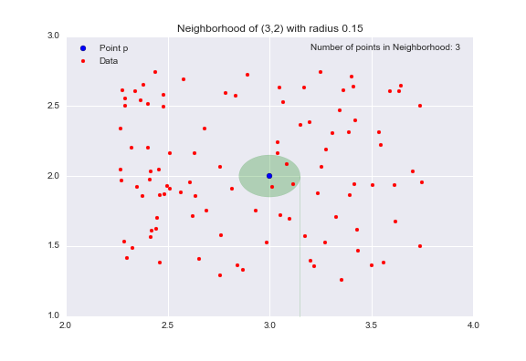
DBSCAN Continued ….
Let’s consider an example to make this idea more concrete. I have scattered 100 data points in the interval [1,3]X[2,4]. Let’s pick the point (3,2) to be our point p.
eps = 0.15
minpoints = 3
The opaque green oval represents our neighborhood, and there are 3 data points in this neighborhood. Hence Point p becomes the core data points as that satisfies a minimum density requirement. Our clusters are built around our core points (hence the core part), so by adjusting our minPts parameter, we can fine-tune how dense our clusters cores must be.

Slide 11
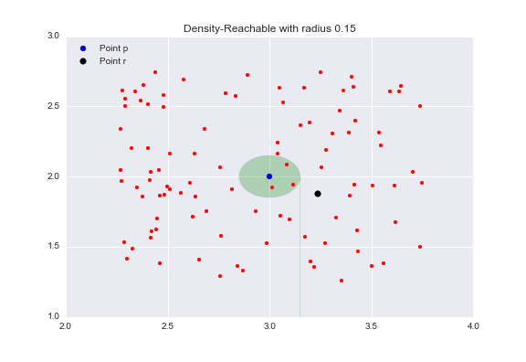
DBSCAN Continued ….
Border Points are the points in our clusters that are not core points.
Consider the point r (the black dot) that is outside of the point p‘s neighborhood.

Slide 12
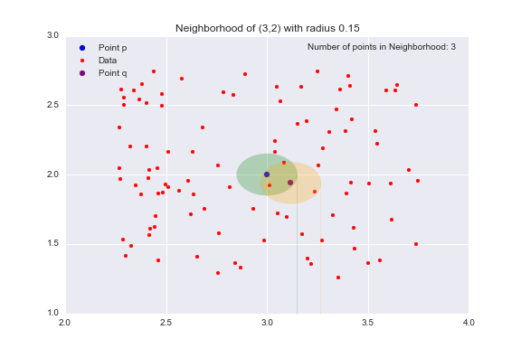
DBSCAN Continued ….
All the points inside the point p‘s neighborhood are said to be directly reachable from p. Now, let’s explore the neighborhood of point q, a point directly reachable from p. The yellow circle represents q‘s neighborhood.
Now while our target point r is not our starting point p‘s neighborhood, it is contained in the point q‘s neighborhood. This is the idea behind density-reachable: If I can get to the point r by jumping from neighborhood to neighborhood, starting at a point p, then the point r is density-reachable from the point p.

Slide 13
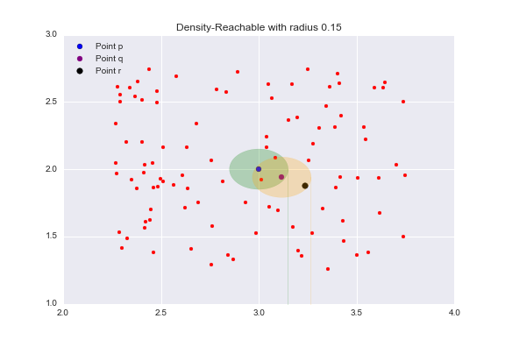
DBSCAN Continued ….
Now while our target point r is not our starting point p‘s neighborhood, it is contained in the point q‘s neighborhood. This is the idea behind density-reachable: If I can get to the point r by jumping from neighborhood to neighborhood, starting at a point p, then the point r is density-reachable from the point p.
Outliers are points that are neither core points nor are they close enough to a cluster to be density-reachable from a core point. Outliersare not assigned to any cluster and, depending on the context, may be considered anomalous points.

Slide 14
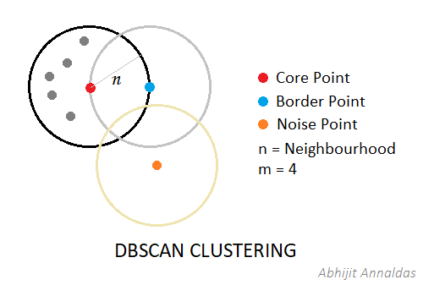
DBSCAN Continued ….
For the sake of explainability, lets refer to a Core point and all the points within distance n as a Core-Set. All the overlapping Core-Sets are grouped together into one cluster. Like multiple individual graphs being connected to form a set of connected graphs.

